Slide 1



Walchand College of Engineering, Sangli
HydroVolt Faucet: Harnessing Sustainable Energy from Water Taps

Slide 2

Presenters:
Name | PRN
Rajwardhan Vichare | 21410058
Vishvajeet Jagtap | 21410059
Aditya Pachore | 21410066
Guided By: Dr.B. G. Patil

Slide 3


Table of Content
Introduction
Objectives
Functioning
Components
Benefits
Future Enhancements
Plan of Action
Applications
Conclusion

Slide 4
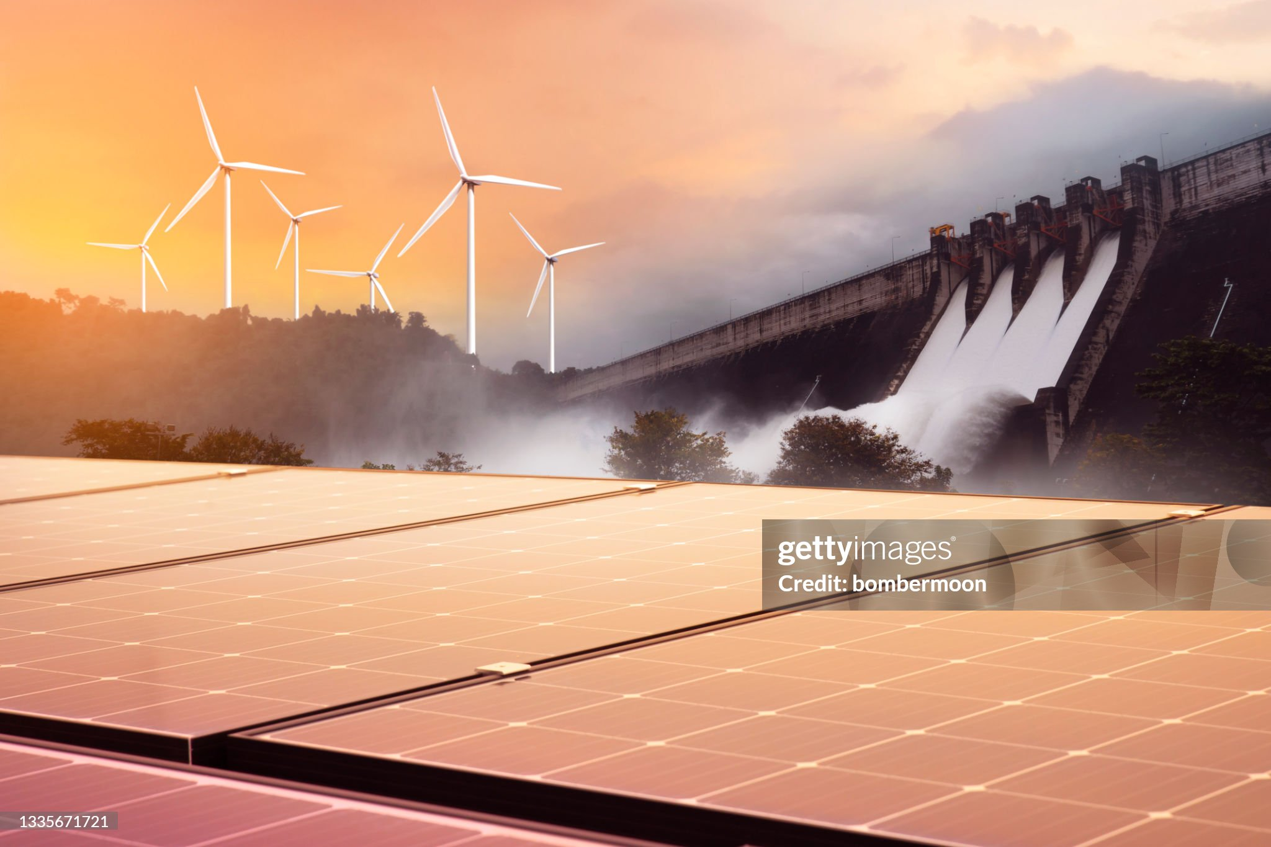

Sustainable Sources

Slide 5
Introduction
Micro-Hydroelectric Technology
User-Friendly Integration
Energy Harvesting from Taps and Pipes
Renewable Energy On-Demand
Environmental Impact

Slide 6
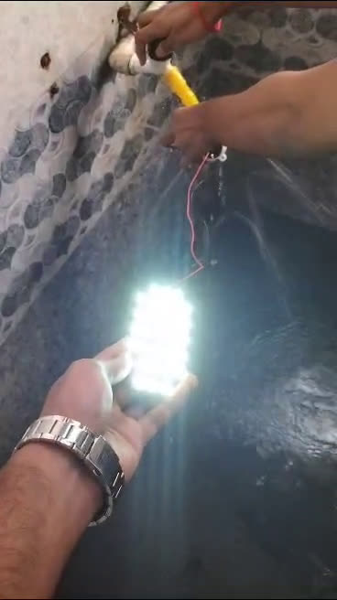
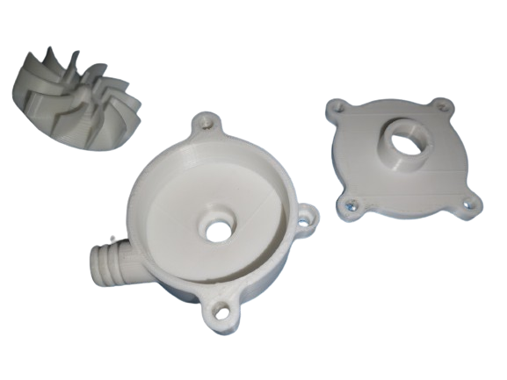
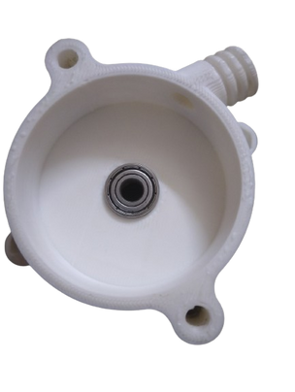

Objectives
1. Design
2. Develop
3. Implement
4. Sustainable Energy

Slide 7
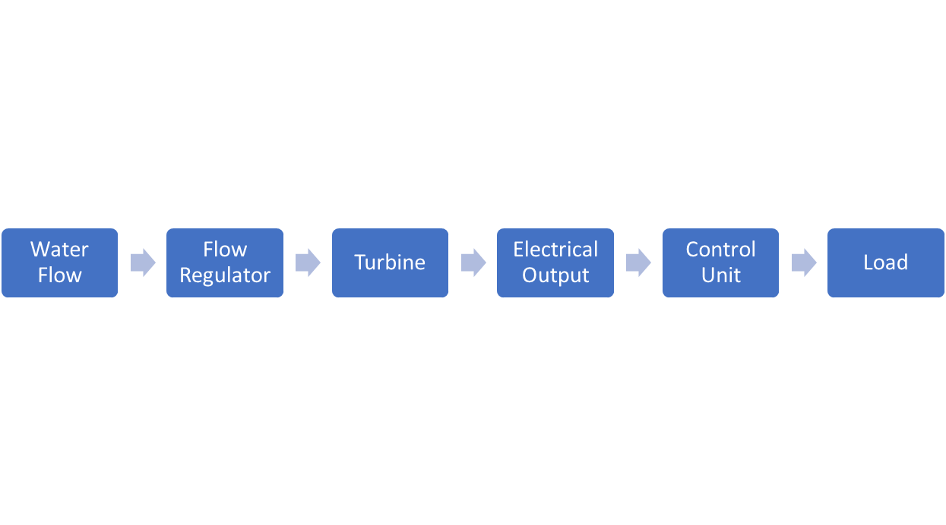
Functioning

Slide 8
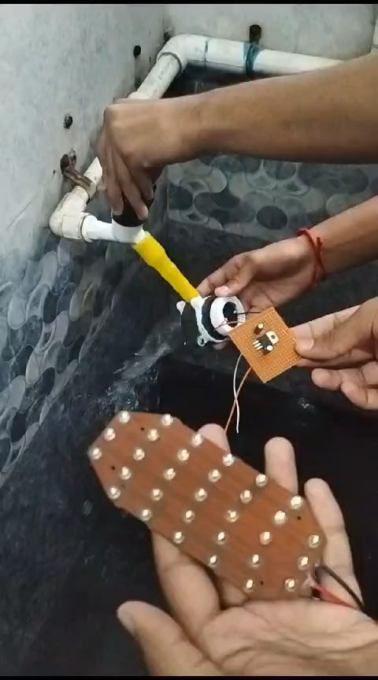
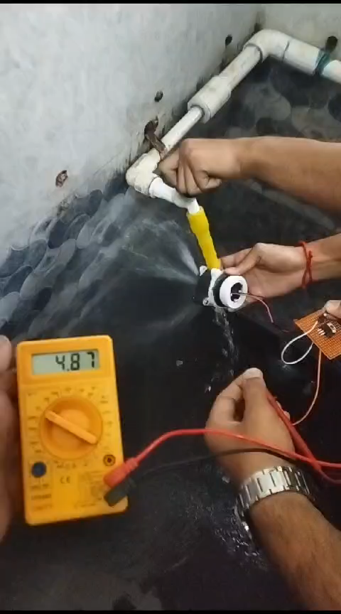

Slide 9
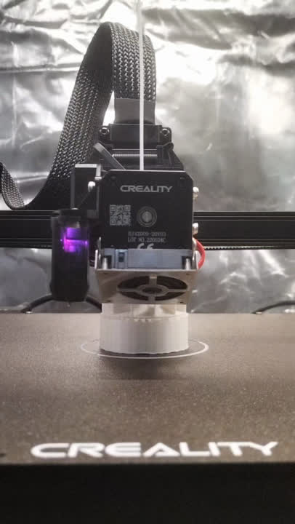
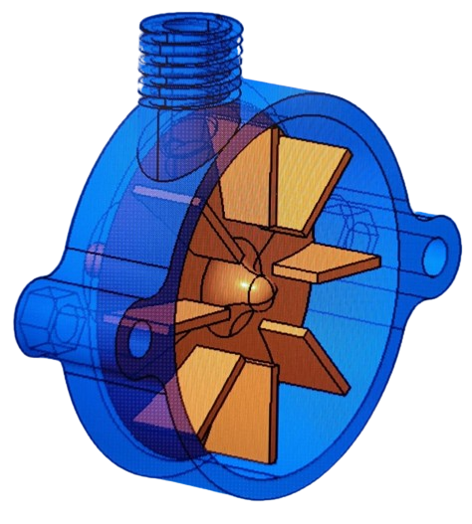

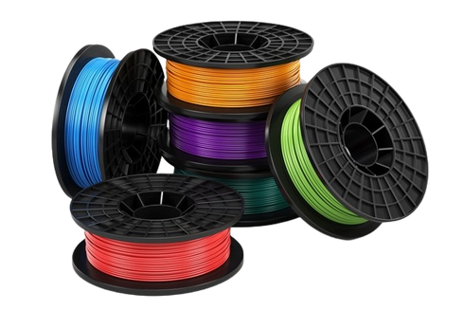
Components
Impulse Turbine
LM7812 IC
Tools for fabrication and assembly

Slide 10
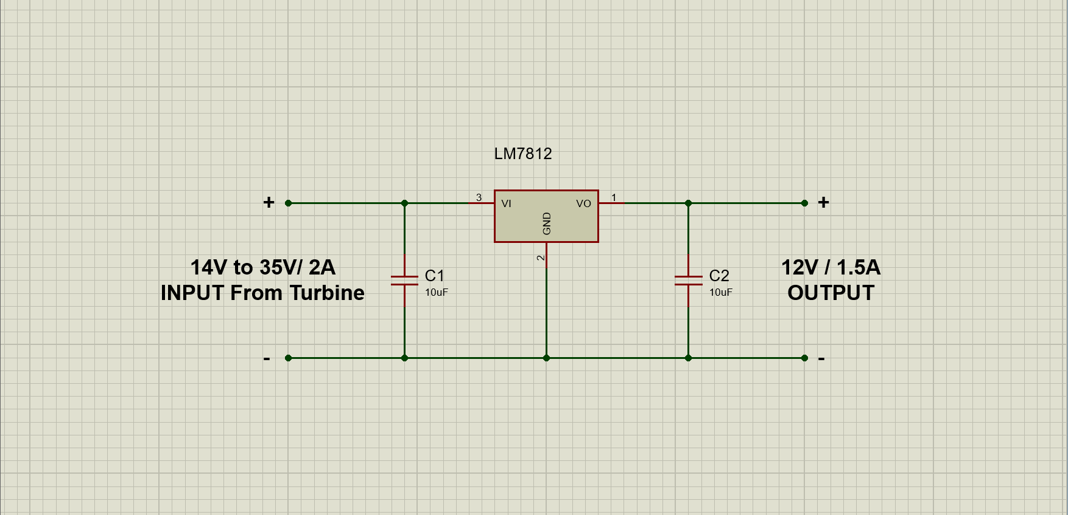
Circuit Diagram

Slide 11
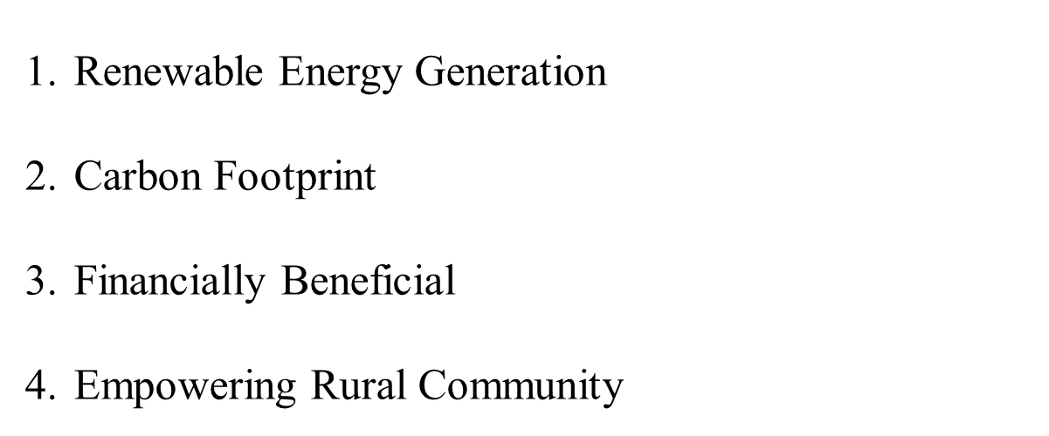
Benefits

Slide 12
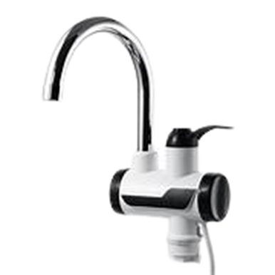
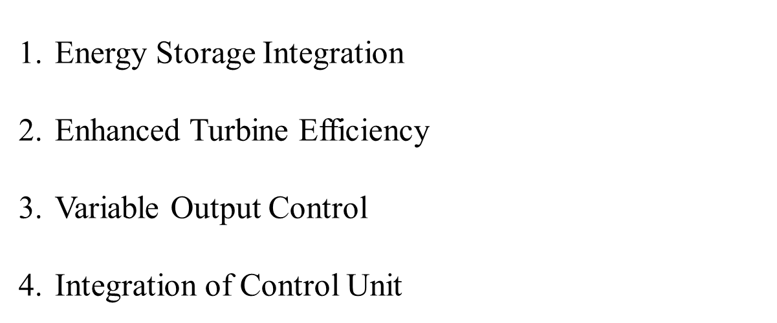
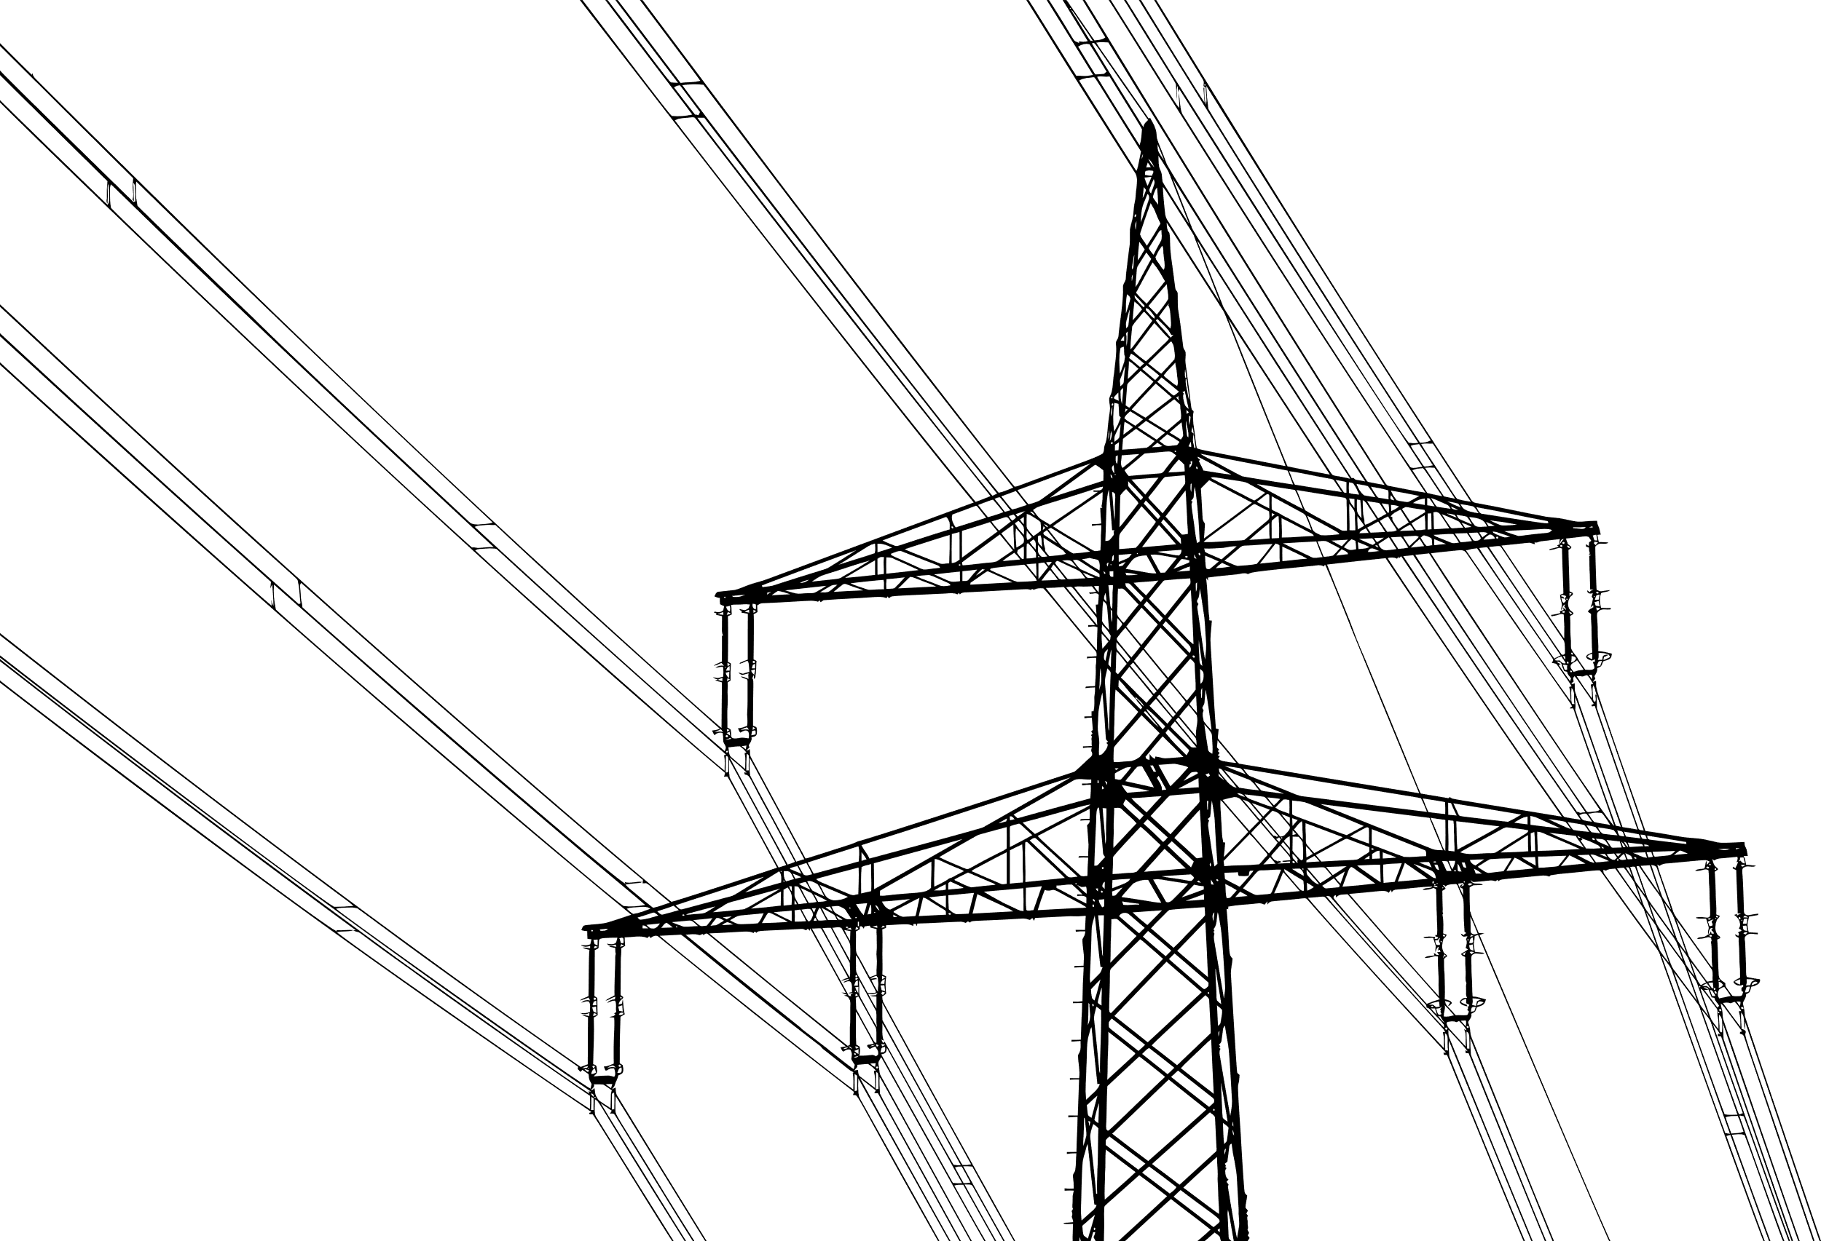
Future Enhancements

Slide 13
Timeline
Actions | Date | Outcome
Title Decision | 1st week of August | Finalized
Data Analysis/Research | 2-4 weeks of August | Finalized
Synopsis | 1st week of September | Finalized
Components Requirements | From 1st week of September | Finalized
Simulation | October | Finalized
Prototype Building | November-December | Finalized

Slide 14
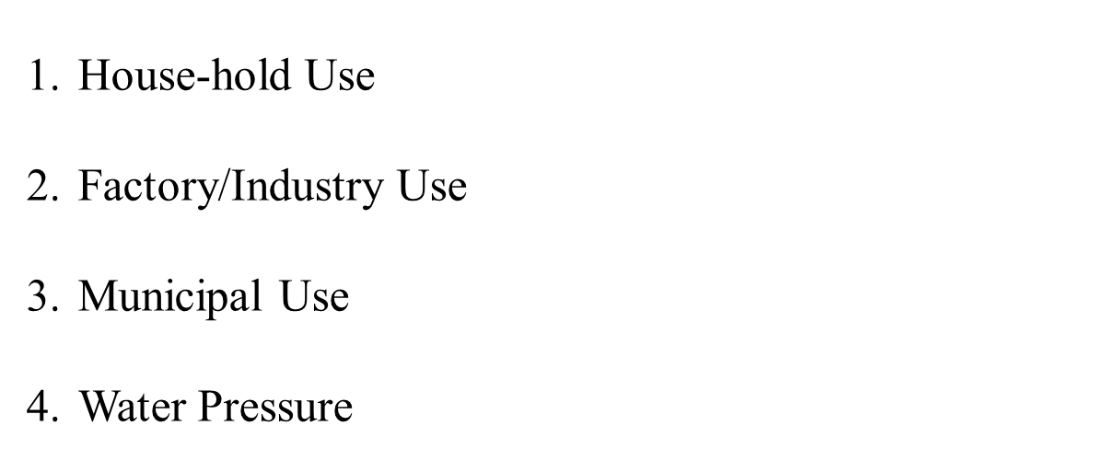

Applications

Slide 15
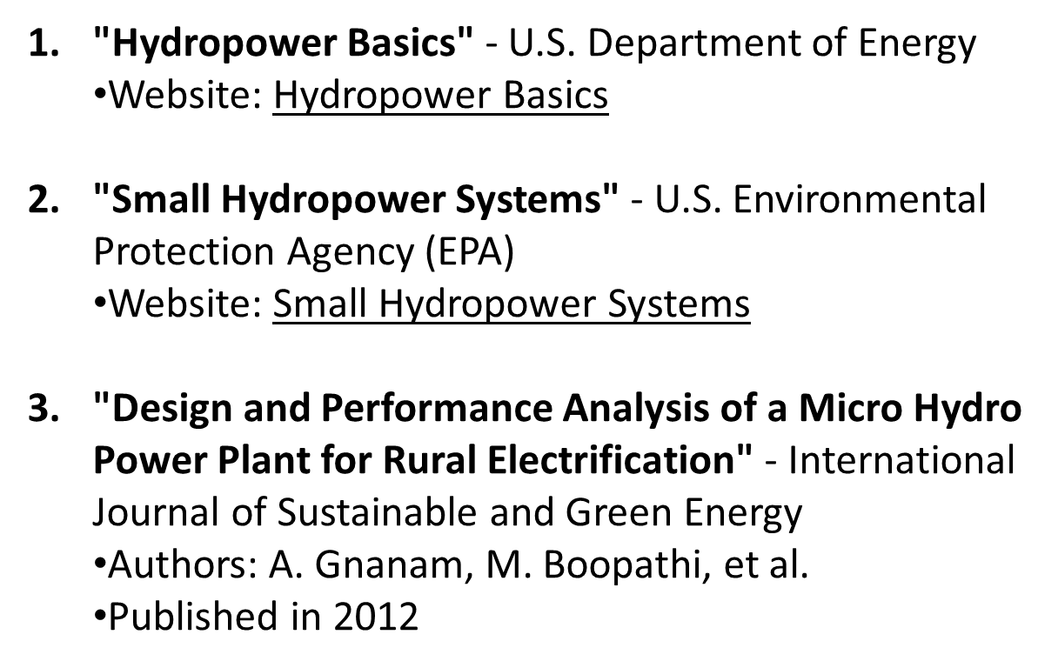
References

Slide 16
Conclusion

Slide 17
Thank You

